Slide 1
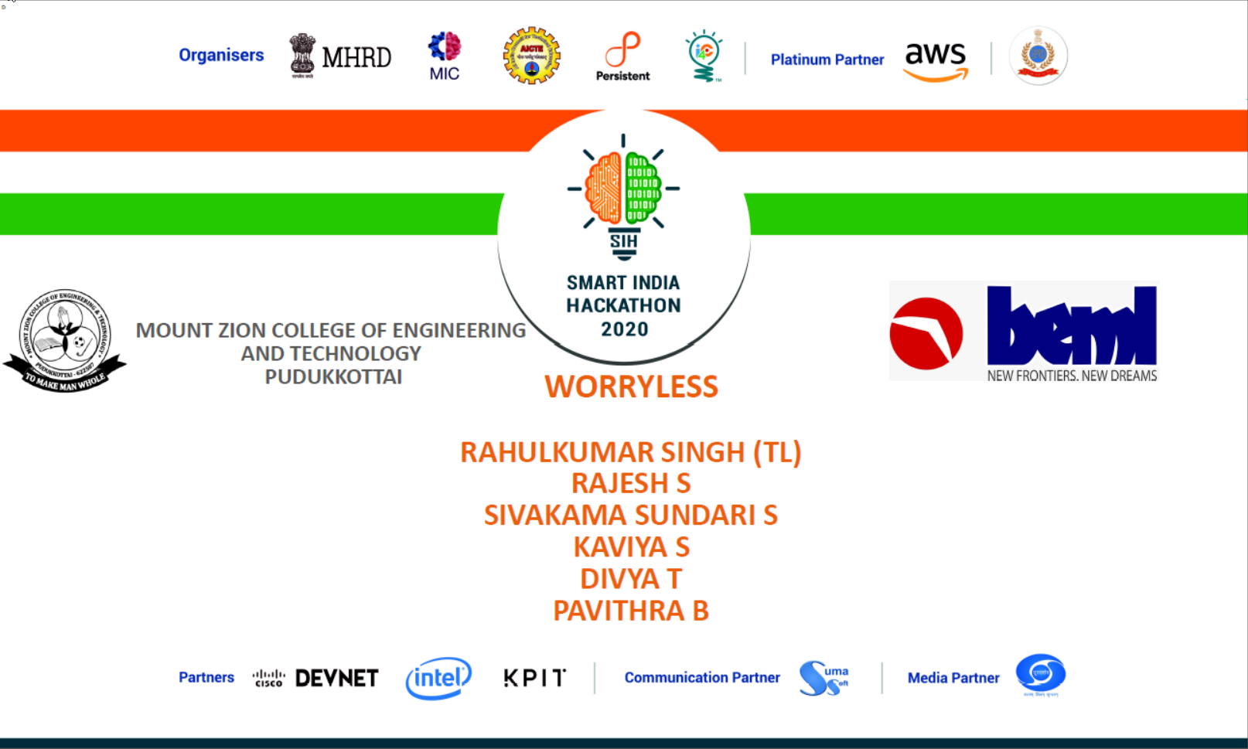

Slide 2
BH60M & BH100 with Electronic Transmission
Securing the CAN J1939 2.0B Communication Protocol, to make RIDES SAFER!

Slide 3
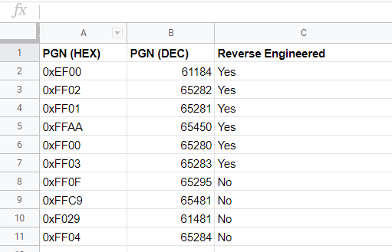
Reversed Engineering
From the sample CAN data provided, 10 PGN were found common,
Out of which 6 were reverse engineered.

Slide 4
Reversed Engineering
In depth information of the findings
0xFF00 - 65280

Slide 5
Reversed Engineering
In depth information of the findings
0xEF00 - 61184

Slide 6
Reversed Engineering
In depth information of the findings
0xFF02 - 65282

Slide 7
Reversed Engineering
In depth information of the findings
0xFF01 - 65281

Slide 8
Reversed Engineering
In depth information of the findings
0xFFAA - 65450

Slide 9
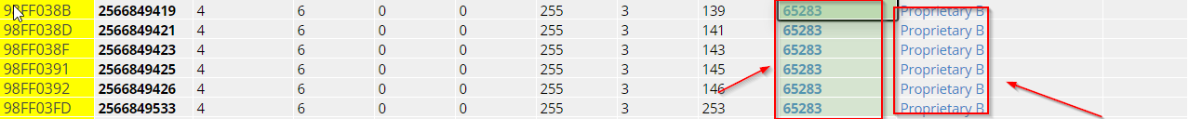
Reversed Engineering
In depth information of the findings
0xFF03 - 65283

Slide 10
Reversed Engineering
Resources that helped!
https://www.altorfer.com/wp-content/uploads/2017/03/PSI-HD_Supported_CAN_Messages_22.pdf
https://pyramidsolutions.com/wp-content/uploads/2018/07/J1939-Data-Mapping-Explained_Final.pdf
https://gurtam.com/files/ftp/CAN/j1939-71.pdf
https://docs.google.com/spreadsheets/d/10f7-TFU9oViSQZYGFYVPDia2w1hd5eOPMlgJXmx31Lg/edit#gid=1130918092
https://michael.chtoen.com/convert-j1939-id-to-pgn.php

Slide 11
Security
As making alteration in the hardware for the purpose of improving security would affect the cost greatly, adding security features to the hardware through software is the key.
Three security ideas:
Foreign Device Identification
Secret Bit Populated in Data Field
Basic High Speed Data Field Encryption and Decryption

Slide 12
Security - Foreign Device Identification
What will it do?
Main objective is identify foreign device in the network.
Identify any information request from OBD2 port and ask for authentication.
Regular but unpredictable check of the number of devices connected in the network.
Cross checking unique hash values of ECU and s/w database.
Identify change in voltage of the network due to ripping off or force connection to the physical network cable.
GUI interface.
Alert user by asking the user if OBD2 port was accessed, if so, request authentication.
Alert if unusual voltage changes are noticed in the network.
Log maintenance for
Hash Checking and Device attendance (alert if mismatch or increase)

Slide 13
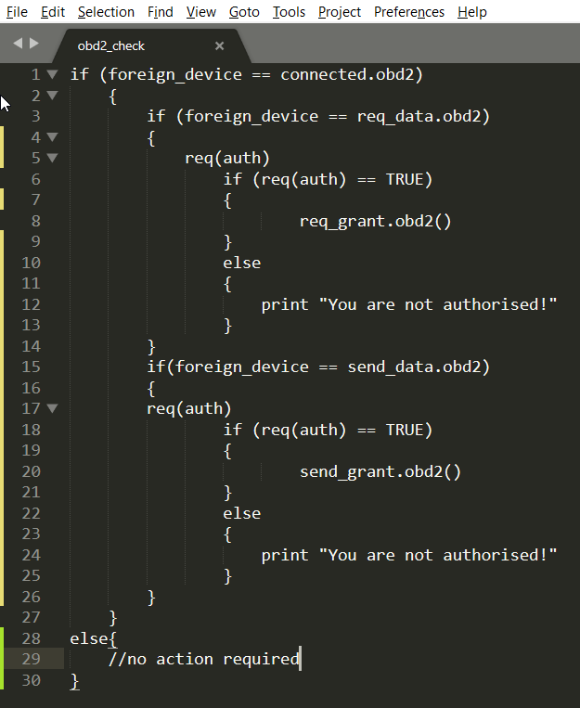
Security - Foreign Device Identification
Identify any information request from OBD2 port and ask for authentication.
Algorithm:

Slide 14
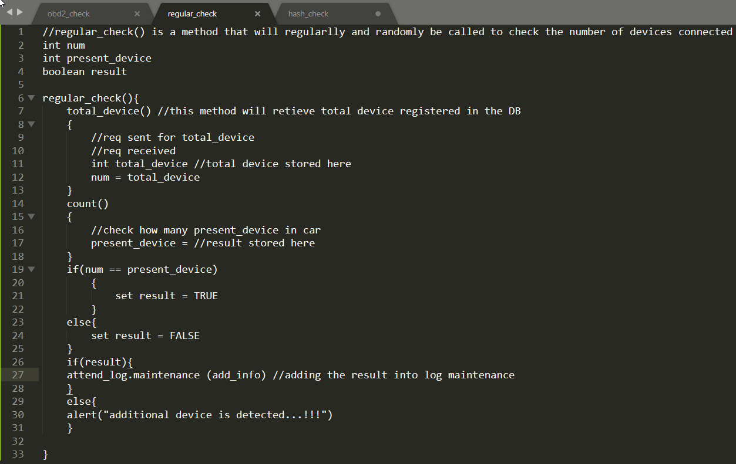
Security - Foreign Device Identification
Regular but unpredictable check of the number of devices connected in the network.
Algorithm:

Slide 15
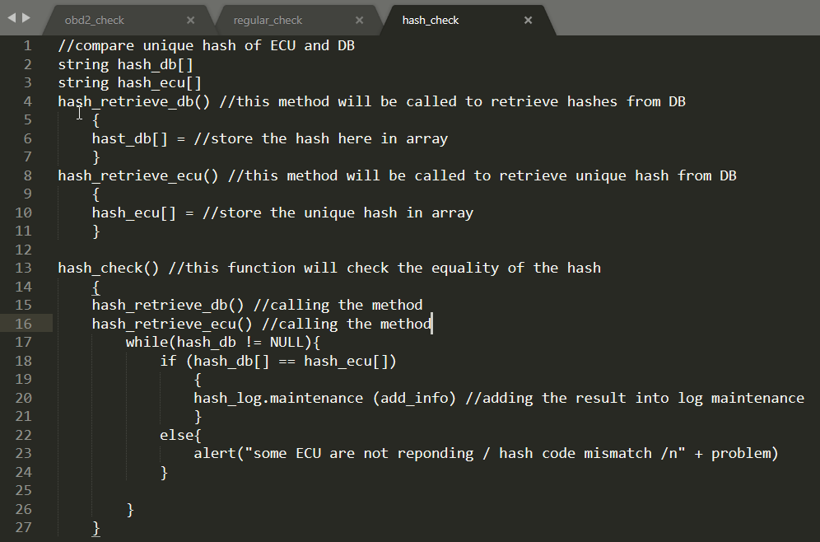
Security - Foreign Device Identification
Cross checking unique hash values of ECU and s/w database.
Algorithm:

Slide 16
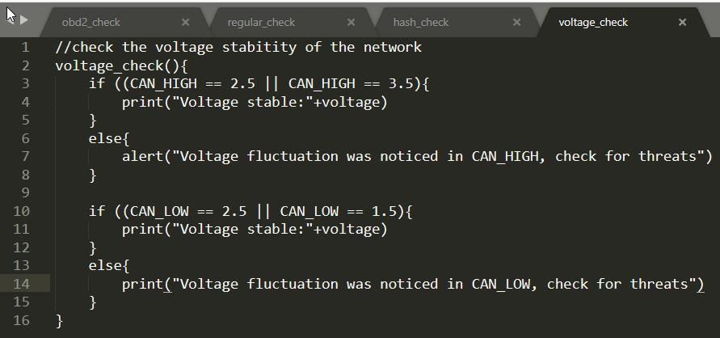
Security - Foreign Device Identification
Identify change in voltage of the network due to ripping off or force connection to the physical network cable.
Algorithm:

Slide 17
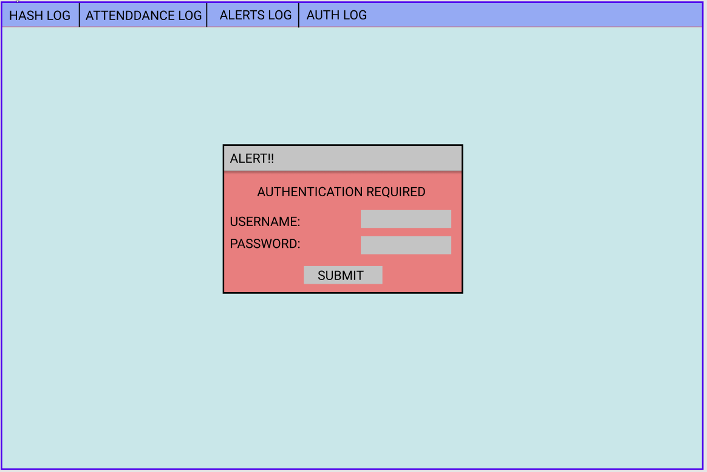
Security - Foreign Device Identification
UI Design

